Slide 1
Kafburg Fintech Performance and Risk Analysis
Presenter Name: Emmanuel Okafor
Designation: Data Analyst

Slide 2
Problem Summary
Kafburg Fintech is experiencing a critical issues with its banking platform.
Customers are complaining that their transactions are failing. We need to know if this is banking error or it is caused by poor network.
Are we stopping fraud we detect.
Is our investment on premium to network provider paying off?
With limited app development, should we focus on the desktop or mobile app development.

Slide 3
Objective of the Analysis
To analyze the dataset of the organization using KPIs.
To design an interactive dashboard that give insights and answer some burning questions.
Prepare presentation slide that captures all the activities, insights and explanation.
Give recommendations based on findings

Slide 4
Dataset Overview
1 dataset is used
Main column used includes Transaction ID, Transaction Status, Transaction Type, Latency, Time, Geolocation, etc.
Data transformation was carried out in changing the data type of Timestamp and splitting the same into Day and Time column. Also splitting Longitude and latitude Column

Slide 5
Key Metrics (KPIs)
Total number of Transaction
Total number of Failed Transaction
Total number of Successful Transaction

Slide 6
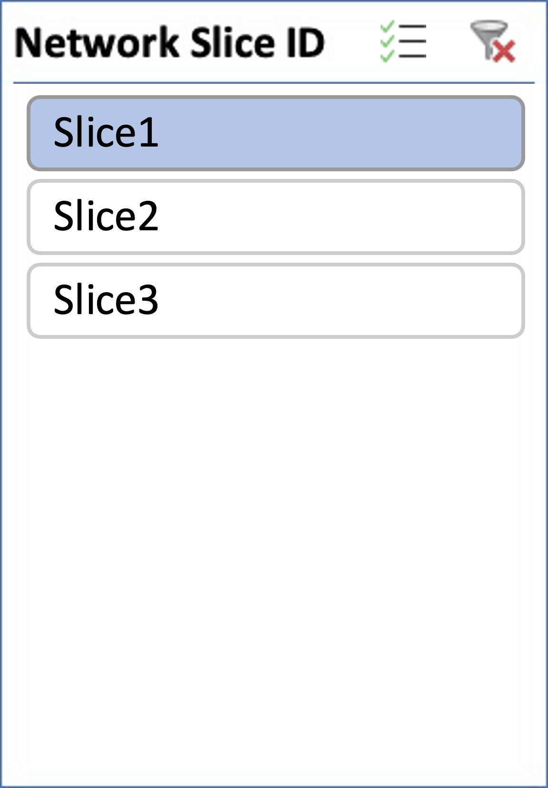
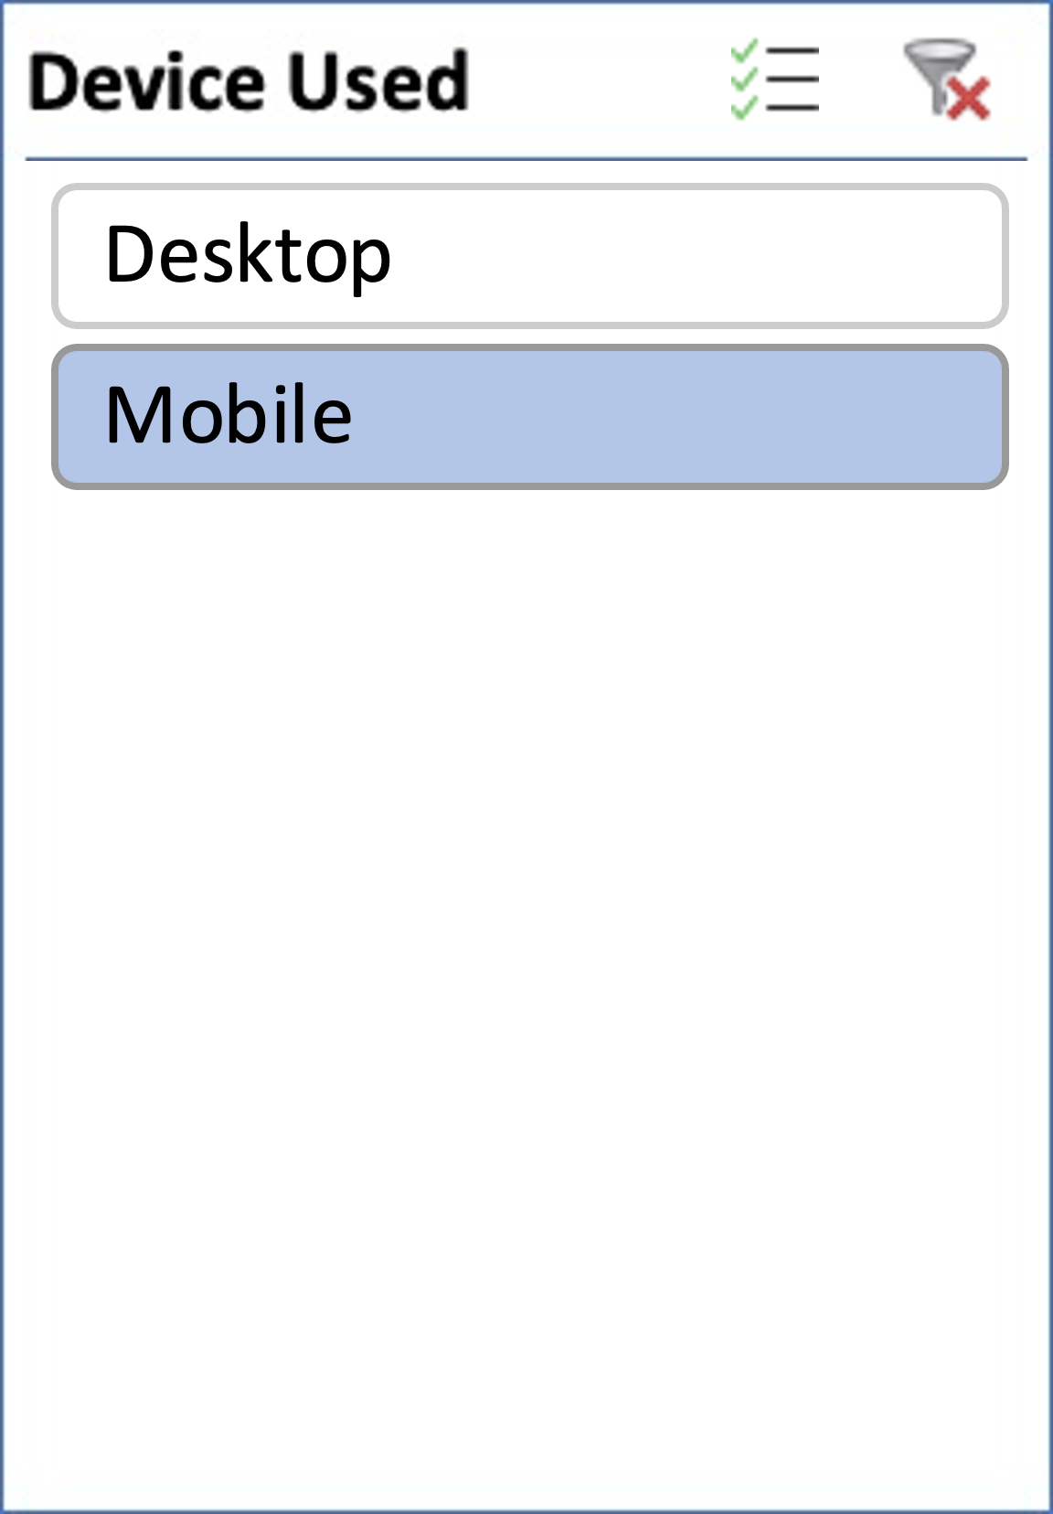
Success/Failure by Transaction Type
Count of Transaction ID | Column Labels
Row Labels | Deposit | Transfer | Withdrawal | Grand Total
Failed | 464 | 457 | 418 | 1339
Success | 1796 | 1838 | 1800 | 5434
Grand Total | 2260 | 2295 | 2218 | 6773

Slide 7
Success/Failure based on Device Used and Geolocation
Count of Transaction ID | Column Labels
Row Labels | Failed | Success | (blank) | Grand Total
34.0522 N | 1296 | 5422 |  | 6718
-74.006 W | 1296 | 5422 |  | 6718
35.6895 N | 1375 | 5307 |  | 6682
-118.2437 W | 1375 | 5307 |  | 6682
40.7128 N | 1339 | 5216 |  | 6555
-74.006 W | 1339 | 5216 |  | 6555
48.8566 N | 1336 | 5338 |  | 6674
2.3522 W | 1336 | 5338 |  | 6674
51.5074 N | 1287 | 5397 |  | 6684
0.1278 W | 1287 | 5397 |  | 6684
55.7558 N | 1336 | 5351 |  | 6687
37.6173 W | 1336 | 5351 |  | 6687
(blank)
(blank)
Grand Total | 7969 | 32031 |  | 40000
Count of Transaction ID | Column Labels
Row Labels | Desktop | Mobile | (blank) | Grand Total
Failed | 3990 | 3979 |  | 7969
Success | 15985 | 16046 |  | 32031
(blank)
Grand Total | 19975 | 20025 |  | 40000

Slide 8
Fraud Flagged chart and App Development
Count of Transaction ID | Column Labels
Row Labels | Failed | Success | (blank) | Grand Total
FALSE | 7572 | 30387 |  | 37959
TRUE | 397 | 1644 |  | 2041
(blank)
Grand Total | 7969 | 32031 |  | 40000
Row Labels | Count of Transaction ID
Desktop | 19975
Mobile | 20025
(blank)
Grand Total | 40000

Slide 9
Summary of Findings
High success rate indicate the transaction failures is not majorly due to bank system failure nor network failure.
No concentration of failures (high failures) towards any factor—Transaction type, Geolocation, Device used, Time, Latency group, slice bandwidth.
Failure is evenly distributed in device used, transaction type, latency group, geolocation, time, slice bandwidth.
The cybersecurity of the is not tight enough to stop transactions marked as ‘Fraud flag’.
At low latency, there is still high failure.
Network slide premium has no impact on operation efficiency.

Slide 10
Recommendations
The banks backend system needs to be upgraded.
Cybersecurity system of the bank need to be upgraded and tightened with most modern advanced tools and technologies to stop transactions marked as ‘Fraud flag’ from going through.
The App development resources has to be equally assigned to Desktop and Mobile App development.
The Fintech should look for another network provider with better services
The transaction app has to be constantly upgraded to infuse recent technology and security measures.

